Slide 1
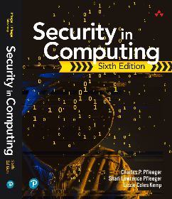
Security in Computing Sixth Edition
Charles P. Pfleeger
Shari Lawrence Pfleeger
Lizzie Coles-Kemp
Chapter 1: Introduction

Slide 2
In This Chapter
Threats, vulnerabilities, and controls
Confidentiality, integrity, and availability
Attackers and attack types; method, opportunity, and motive
Valuing assets

Slide 3
Real-Life Scenario Example
2013 TV hoax, hacking into the U.S. Government Emergency Alert System
Computers manage our everyday lives. What could go wrong?
What about privacy and safety?
Notes:
Instructor to reference textbook scenario on the 2013 TV hack hoax that broadcast an emergency message about zombies, akin to 1938 H.G. Wells novel War of the Worlds)

Slide 4
What Is Computer Security?
Computer security is the protection of assets of a computer/computer system
Consider the Vulnerability–Threat–Control paradigm
Prevent attacks and use control or countermeasures

Slide 5


Value Assessment
Assess individual, collective, and intrinsic or sentimental value
Consider intellectual property, trade secrets, personal data etc.
Distinguish between replaceable and irreplaceable assets

Slide 6
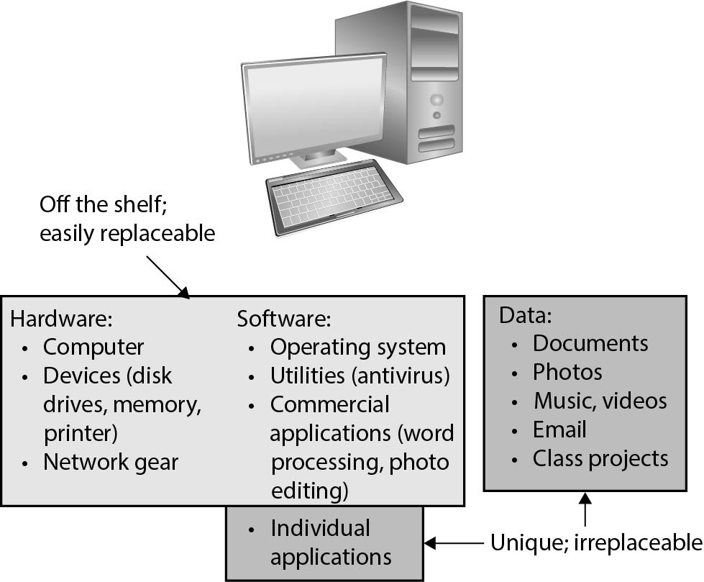
Values of Assets
FIGURE 1-3 Values of Assets

Slide 7
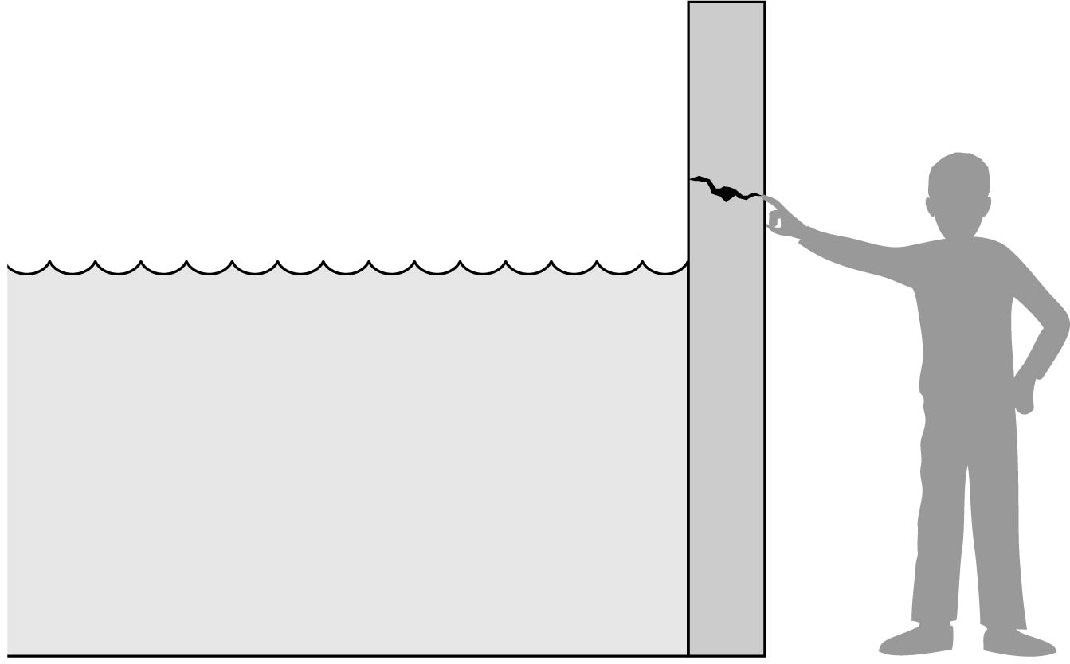
Threat and Vulnerability
Should you ignore the crack in the wall until the water level goes up?
When does the crack become a threat?
FIGURE 1-4 Threat and Vulnerability

Slide 8
Threat Properties
Three security properties to consider:
Integrity
Authentication
Nonrepudiation or accountability
C-I-A Triad: Confidentiality, Integrity, Availability
Three characterizations of harm:
Interception
Interruption
Modification

Slide 9
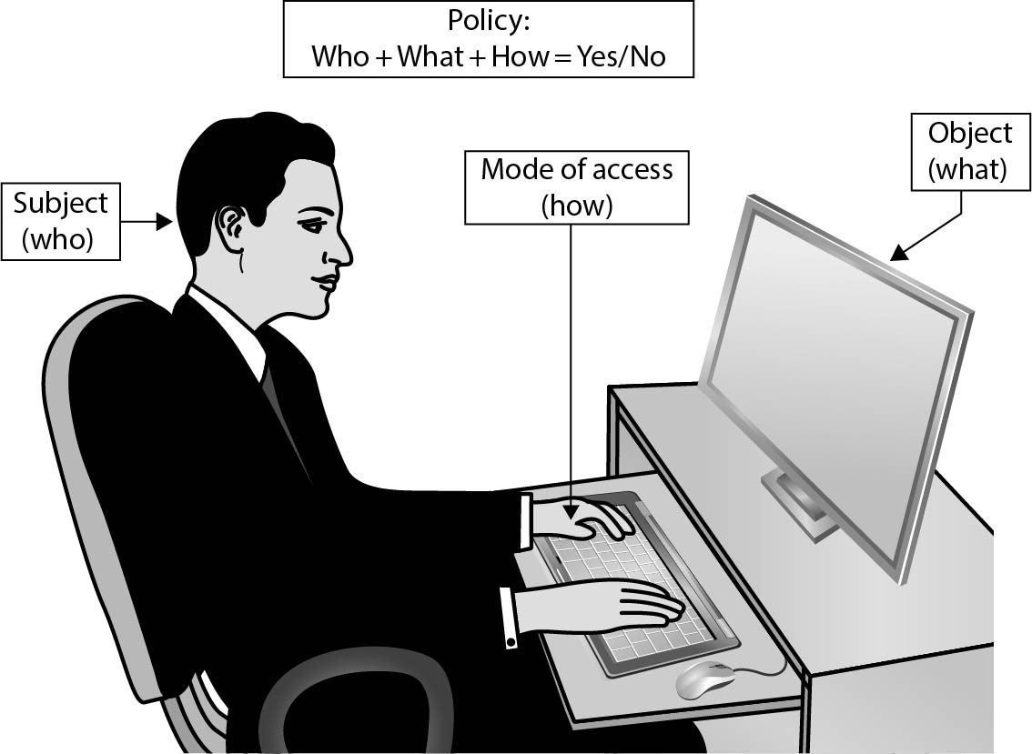
C-I-A Triad: Confidentiality
A good security policy defines appropriate mode of access for subjects, as well as proper access level
Many government agencies, especially military, provide security level access on "need to know" basis
FIGURE 1-6 Access Control

Slide 10
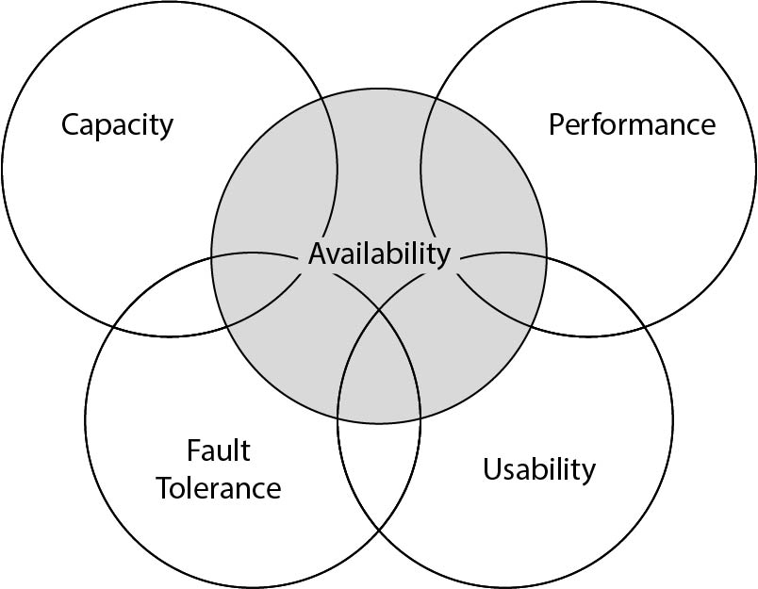
C-I-A Triad: Availability
Applies to data and services
Definition of availability depends on following:
It is present in a usable form
It has enough capacity to meet the service’s needs
It is making clear progress, and, if in wait mode, it has a bounded waiting time
The service is completed in an acceptable period of time
FIGURE 1-7 Availability and Related Aspects

Slide 11
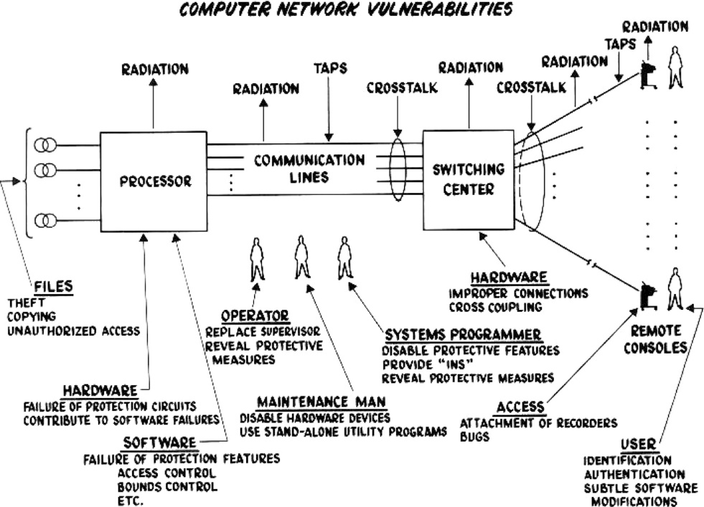
Computer Network Vulnerabilities
A small, centralized control of access is fundamental to preserving confidentiality and integrity
Security challenge: Designing effective availability policies
FIGURE 1-8 Computer [Network] Vulnerabilities (from [WAR70])

Slide 12
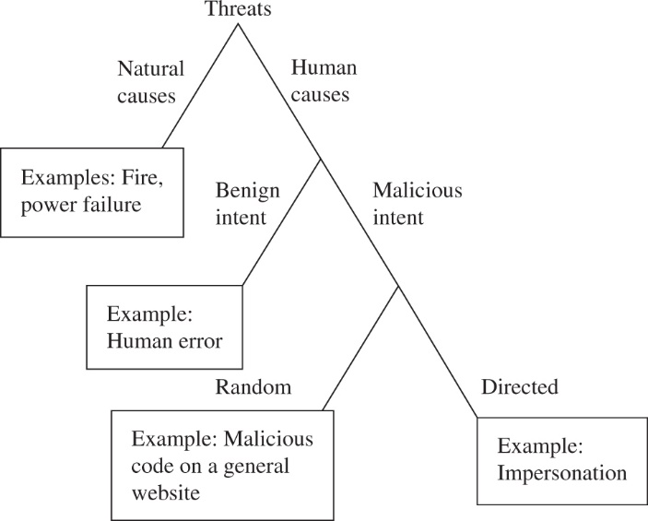
Threat Options
Threats:
Human/nonhuman
Malicious/non-malicious
Random attacks
Directed attacks
Common Vulnerability Scoring System (CVSS) provides a standard measurement system that allows accurate and consistent scoring of vulnerability impact
FIGURE 1-9 Kinds of Threats

Slide 13
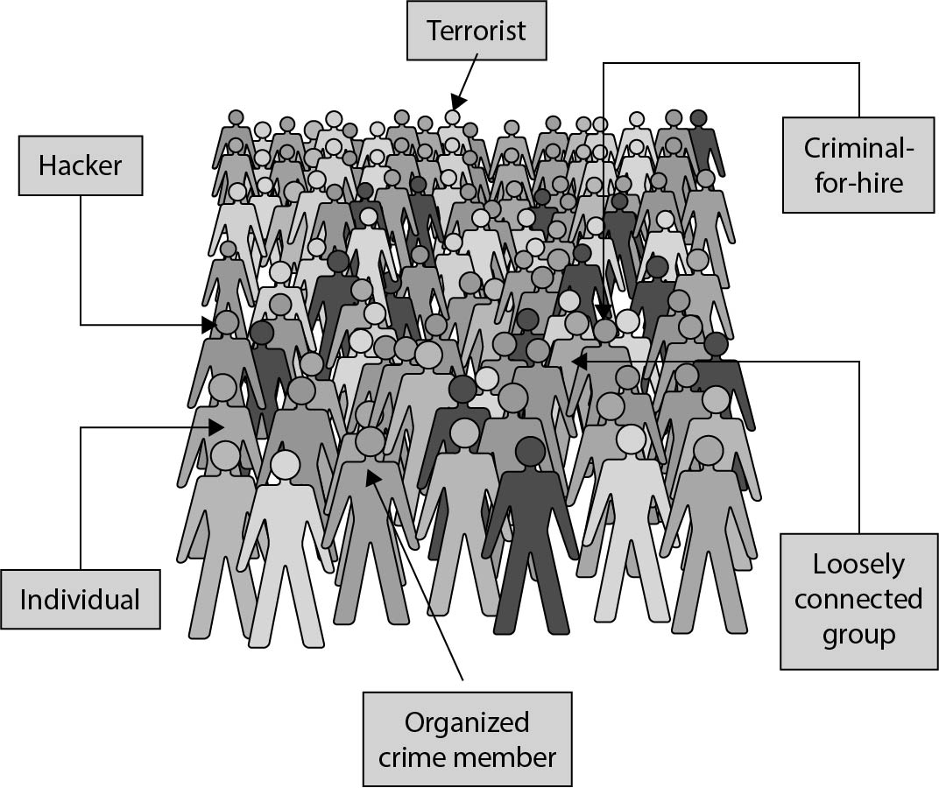
Attackers
Cyberthreats/cyberattackers
Advanced persistent threats
Types of attackers:
Individuals
Worldwide groups
Organized crime
Terrorists
FIGURE 1-10 Attackers

Slide 14
How Terrorists Use Computers
Computer as target of attack
Computer as method of attack
Computer as enabler of attack
Computer as enhancer of attack

Slide 15
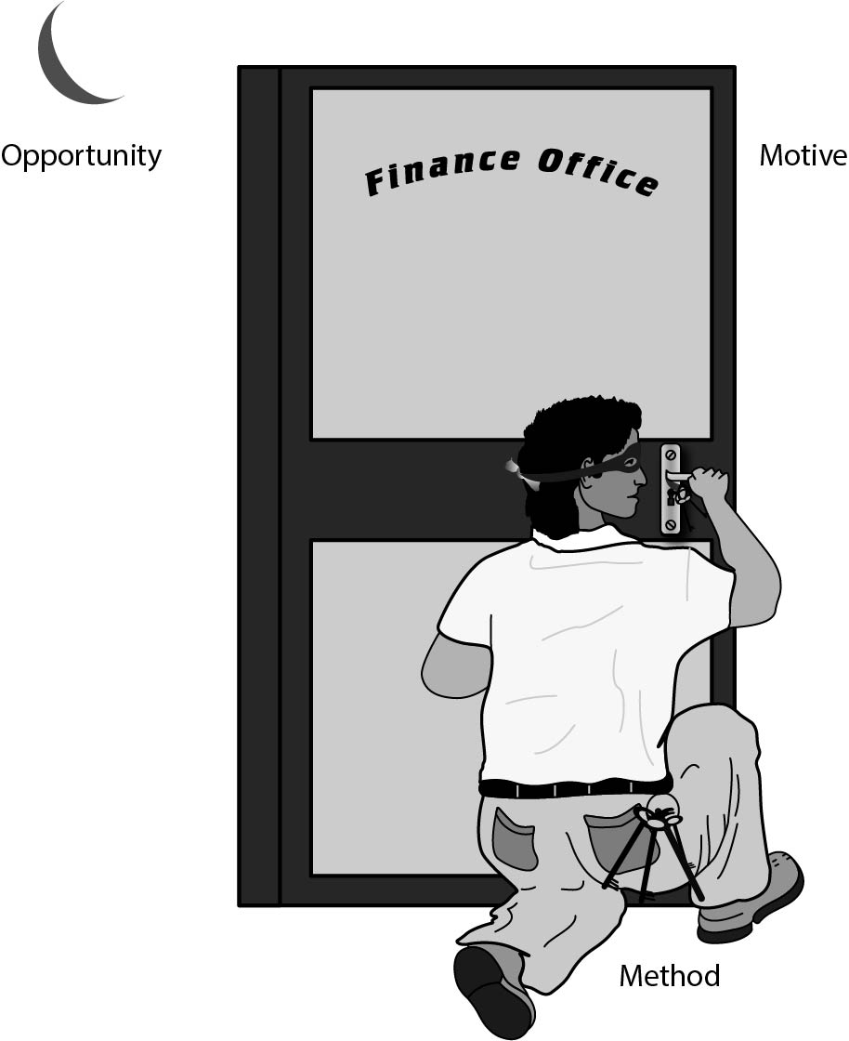
Method-Opportunity-Motive
The negative consequence of an actualized threat is harm
To minimize harm: perform risk management to assess likelihood of event occurrence and magnitude of impact
The risk that remains uncovered by controls is called residual risk
FIGURE 1-11 Method–Opportunity–Motive

Slide 16
Vulnerabilities
Vulnerabilities are weaknesses that can allow harm to occur
Computer vulnerabilities:
Weak authentication
Lack of access control
Errors in programs
Finite or insufficient resources
Inadequate physical protection

Slide 17
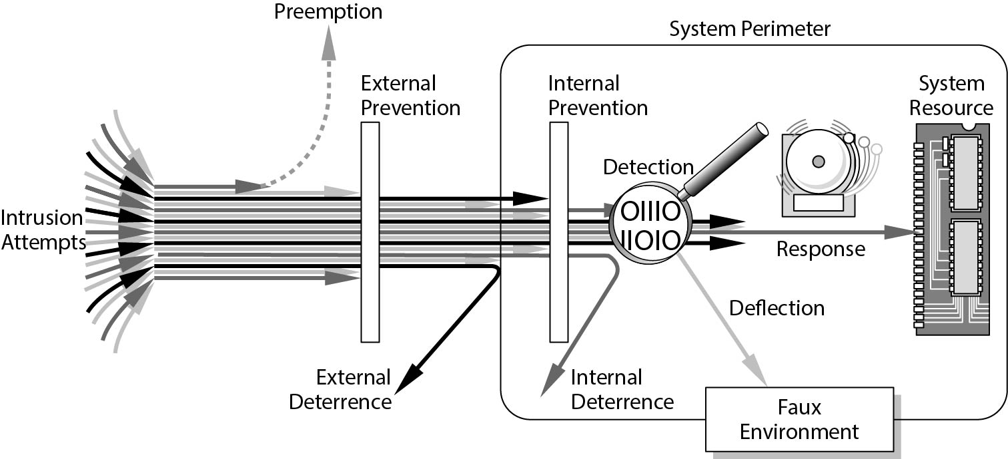
Controls
How to deal with vulnerabilities:
Prevent
Deter
Deflect
Mitigate
Recover
FIGURE 1-12 Effects of Controls

Slide 18
Types of Countermeasures
Physical controls:
Locks, walls/fences, (human) guards, sprinklers and/or fire extinguishers
Procedural or administrative controls:
Laws, regulations, policies, procedures, guidelines, copyrights, patents, contracts, agreements
Technical controls:
Passwords, program or operating system access controls, network protocols, firewalls, intrusion detection systems, encryption, network traffic flow regulators

Slide 19
Summary
Distinguish between threat, vulnerability, and control
Be aware of the constant change in network security
Continue to learn:
Seek foundational knowledge, including basic terminology and techniques
Be proactive in assessing risk and protecting the network
Be vigilant and informed about new threats and solutions

Slide 20
What's Next?
Examples of failed security systems
Closer look at three powerful and widely used security protection methods:
Identification and authentication
Access control
Encryption

